Slide 1
MWIS Survey Results, USC Interviews, and ESOL Teachers As Niche Material Writers
Eric H. Roth, University of Southern California MWIS TESOL Panel on Gaps in ESOL Textbooks
Baltimore, Maryland April 8, 2016
2016 TESOL

Slide 2
Personal Biases
Teacher for over 25 years
Always found gaps between my students & the textbooks
Bed-Stuy Outreach H.S. – late and too difficult
USC Engineering Writing Program
Current USC American Language Institute (ALI)

Slide 3
Textbook Selection Issues
Who decides?
Education departments – school boards
Textbook publishers
Principals
Department heads
Faculty committees
Classroom teachers

Slide 4
The Appeal of Checklists
Rational decision
Consistent standards
Rich literature in ESOL
Implement education reforms
ALI has discussed for three years
Program
Course level

Slide 5
Problematic Ways to Select Textbooks
Cool Cover
Inertia
Published in 2015 and 2016
Available
Good enough

Slide 6
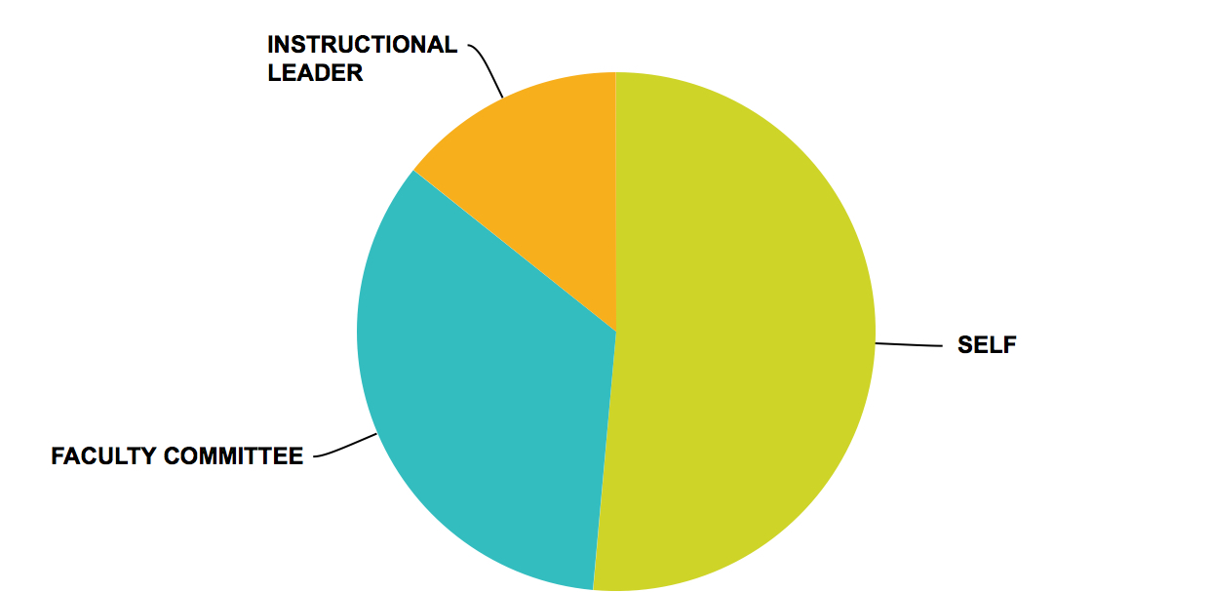
THE TEXTBOOK ADOPTION DECISION (FOR
REGULARLY USED TEXTS) IS MADE BY…
35 TEACHERS RESPONSES
Notes:
Self 16, Committee 12 Leader 5

Slide 7
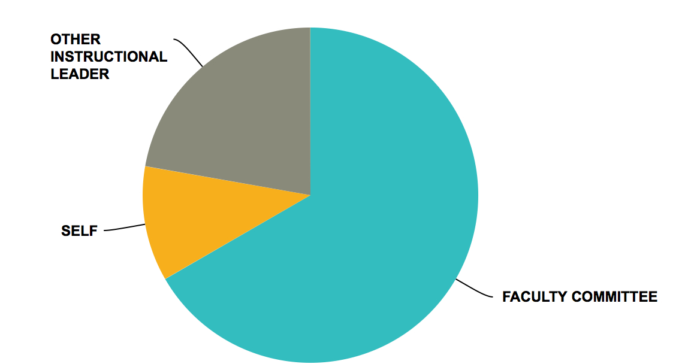
THE TEXTBOOK ADOPTION DECISION (FOR
REGULARLY USED TEXTS) IS MADE BY…
NOTE: OPTION OF INDIVIDUAL TEACHER NOT SELECTED
9 COORDINATORS & OTHERS RESPONSES
Notes:
Self 1
Other leader 2
Committee 6

Slide 8
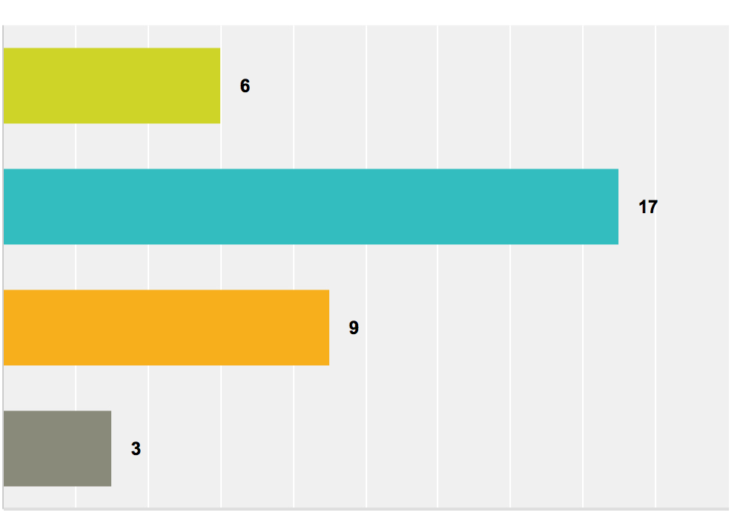
Number of Books Considered Before Selection
None
1-3
4-6
More than 6
7
21
10
6

Slide 9
Use of a Textbook Checklist
YES | 9
NO | 24
NOT SURE | 11
WAS IT USEFUL?
7 out of 17 said yes.
Notes:
CommentsOf the workshops which were presented by the teacher trainers of the course book series were very useful and very nice, but there were not enough time for everyone to write their comments and some of the instructors at our school didn't attend the meetings and they didn't write their comments after those meetings.
I chose the Interactions textbook without a checklist. The Ventures text was chosen before I joined the team. I don't know if a checklist was used for that decision. I don't know if she had one in mind or not. A checklist would have been helpful, yet
was not here, do not know
We evaluated 3 texts with a checklist two years ago. Future came out on top. Ventures was our second choice. With the new edition of Ventures available, we switch to Ventures now
Don't think they are using one.
It helps focus on key aspects of different coursebooks
We were looking for an entry level book for beginners.
We did not have a checklist, it would be very useful if we had a comparision list as we are now moving towards students purchasing their own textbooks.
ADM/COORD/TEACHER EDUCATOR COMMENTS
We do have a textbook selection checklist that has been shared with all schools.
The checklist gives the textbook writers a sense of direction and single-mindedness.
Fairly useful
A checklist would have been a far more logical idea, to see how each book met the goals and objectives of the curriculum.

Slide 10
Problems with Checklists?
Pro: “It helps focus on key aspects of different coursebooks.”
“We did not have a checklist. It would be very useful if we had a comparison list.”
Yet majority indicated of ELT experts who used checklists did not find them useful. Why?
Gap between checklists and course objectives
Too simple? Too complicated? Other?
Insufficient information
Survey suggests that many ELT textbook checklists have limits

Slide 11
Making Checklists Work
Designed for individual classes, not entire program
Focus on course objectives
Note strengths of books
Open to supplemental materials
Encourage reflection on course
Other?
Cons: time consuming, reduces autonomy

Slide 12
USC ALI Interviews
Small English department
International students – mostly graduate & mostly required
Some undergrads & some volunteers
Interviewed six USC instructors last year
Interviewed three additional lecturers in February and March 2016
20 minute – 45 minute interviews

Slide 13
Six Perspectives on Writing Textbooks
We have no good choices for academic & professional writing. JK
Writing has changed with social media; textbooks not so much. RJ
Students expect to buy a textbook; make it a reference. BG
It’s impossible to predict next tech apps; you can’t future proof books. BW
I’m not a page turner; I’m a creative educator. KCG
Our students don’t need textbooks; they need to write in their field. JP

Slide 14
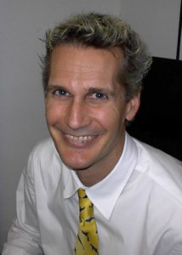
Five Perspectives on Writing Textbooks
Barry Griner – Master Lecturer, former writing coordinator
Students expect to buy a textbook
Students want an appropriate, challenging (non-ESL) textbook
Focus on smaller, academic writing tasks for ESL students
Emphasize learning expectations as a junior member of a field
Promote as a reference book and a “keeper”

Slide 15
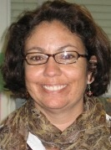
Five Perspectives on Writing Textbooks
Julie Kirkpatrick - Senior Lecturer & testing coordinator
Teaches intermediate writing class
Need textbooks that provide academic and business writing
“We don’t have good choices.”
Reading and writing too hard given grammar skills
Used parts of a out of print 1987 writing textbook

Slide 16
Five Perspectives on Writing Textbooks
Richard Jones – part time ALI lecturer and editor of Japanese academics
Writing has changed with social media and technology
Students need help with vocabulary and register
Focus writing tasks on transferrable skills in short exercises
Students must tell stories in English to different audiences
Help students write for academic, professional, and social audiences

Slide 17
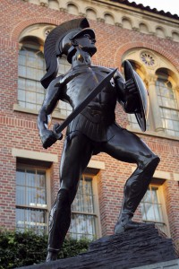
Five Perspectives on Writing Textbooks
Brent Warner– IEP and community college writing instructor
It’s impossible to predict which next tech apps students will use
“You can’t future proof books. Look at all the MySpace references!”
Writing has changed. Teach online writing with blogs.
“Too many English teachers are luddites.”

Slide 18
Five Perspectives on Writing Textbooks
James J. Polk - Senior Lecturer and textbook writer
Graduate students write for specific audiences with precise vocabulary.
Teach skeletal phrases and collocation
Analyze papers from their own disciplines
“Our students don’t need textbooks.”

Slide 19
My Story: Creating Materials for an Advanced Conversation Class
Santa Monica Community College
Advanced ESL Conversation (non-credit)
Expensive Textbook with vocabulary lists and cartoons
Materials for class – ages 18-87, many native tongues
Students chose topics
Many students volunteered for class – over and over

Slide 20
Why do it?
Contributes to the field as teacher & writer
Improves your teaching
Encourages reflection
Share experiences & values
Professional development
New career opportunities
Open up new revenue sources

Slide 21
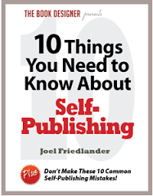
Do your research as a self-publisher!
Plus:
Friedlander, Joel. "10 Things You Need to Know About Self-Publishing." The Book Designer. N.p., n.d. Web. Mar. 2016.
(Points 7-10 are exceptionally useful.)
FREE RESOURCE!

Slide 22
“Success is going from failure to failure without losing enthusiasm.”
Winston Churchill (1874-1965)

Slide 23
References
Bowerman, Peter. The Well-Fed Self-Publisher: How to Turn One Book into a Full-Time Living. Revised ed. Atlanta, GA: Fanove Pub., 2013. Print.
Lepionka, Mary Ellen. Writing and Developing Your College Textbook: A Comprehensive Guide to Textbook Authorship and Higher Education Publication. 2nd ed. N.p.: Atlantic Path, 2008. Print.
Silverman, Franklin H. Self-Publishing Textbooks and Instructional Materials: A Practical Guide to Successful - And Respectable - Self-Publishing. Gloucester, MA: Atlantic Path Pub., 2004. Print.
Rich, Jason. Self-Publishing for Dummies. Hoboken, N.J: Wiley Pub., 2006. Print.
Eltjam.com
Eltteacher2writer.co.uk
TeachersPayTeachers.com
DollarPhotoClub.com
Conversations and interviews with Barry Griner, James Polk, Julie Kirkpatrick, Mark Treston, Richard Jones, Nina Kang, Katherine C. Guevara, Jim Valentine, & Brent Warner

Slide 24
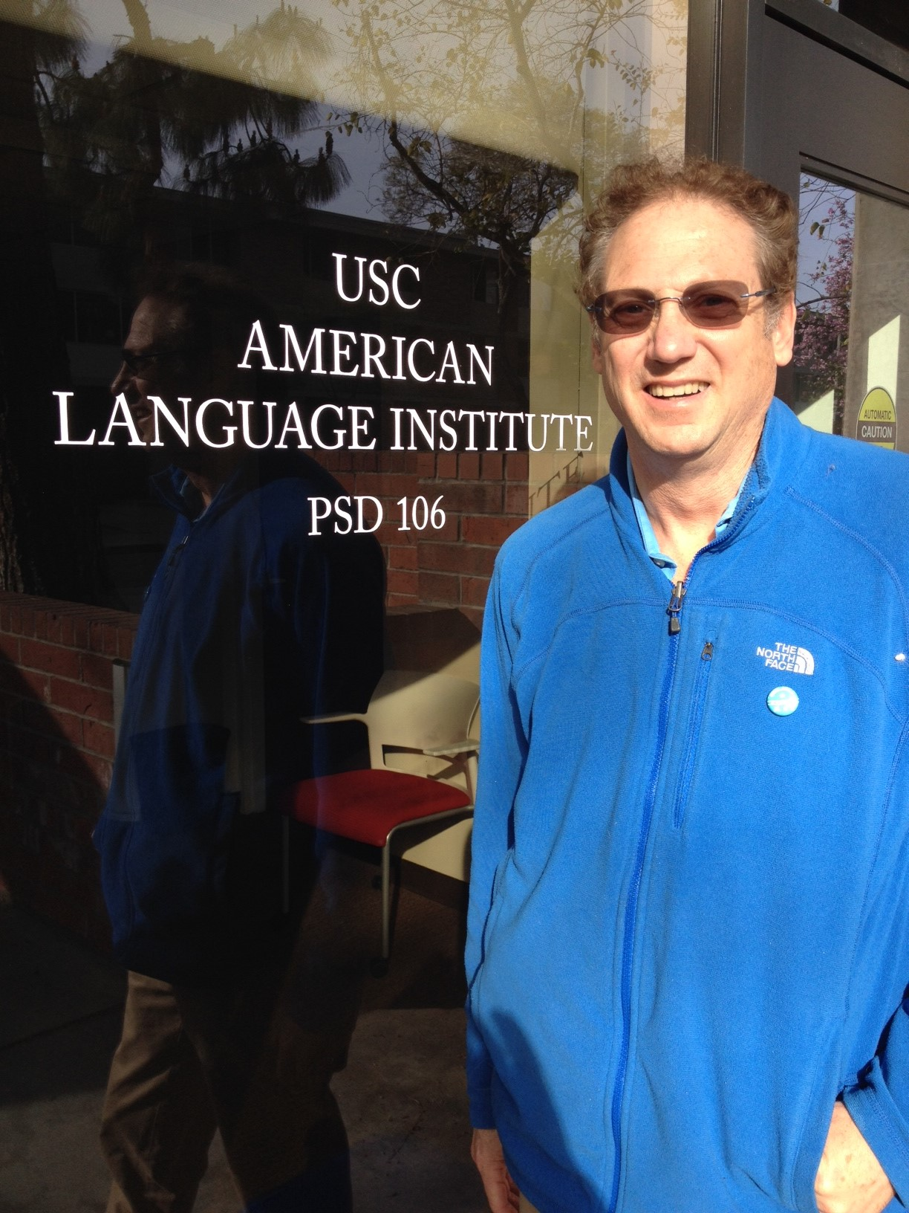
Thank you!
Questions? Comments?
Contact ericroth@usc.edu

